Slide 1
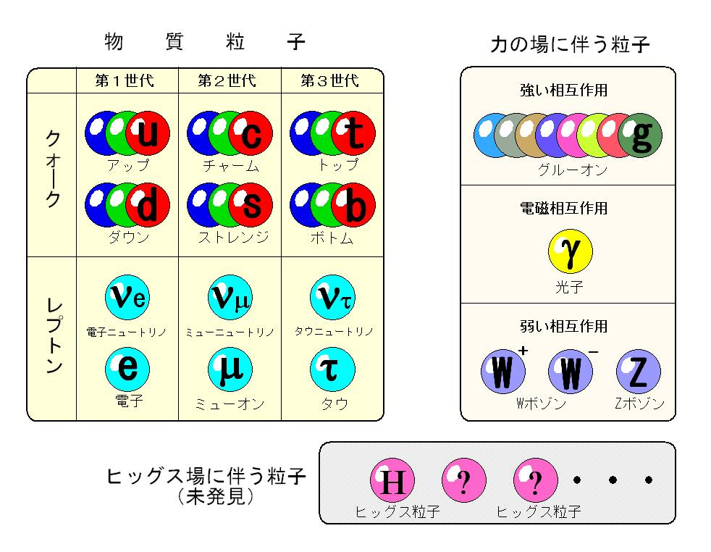
matter fermions
gauge bosons
1st generation
2nd generation
3rd generation
Strong force
Quarks
up
charm
top
gluons
Electro-magnetic force
down
strange
bottom
photon
Leptons
μ neutrino
τ neutrino
Weak force
e neutrino
electron
muon
tau
W bosons Z boson
Higgs particles
associated
with Higgs field

